Slide 1

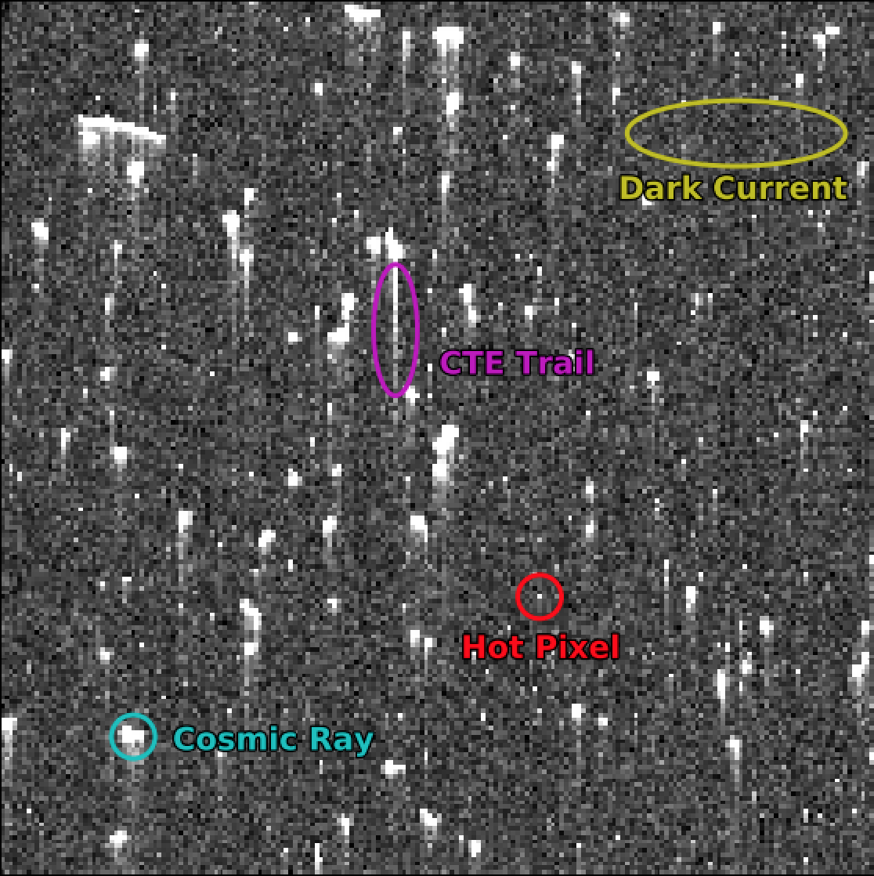
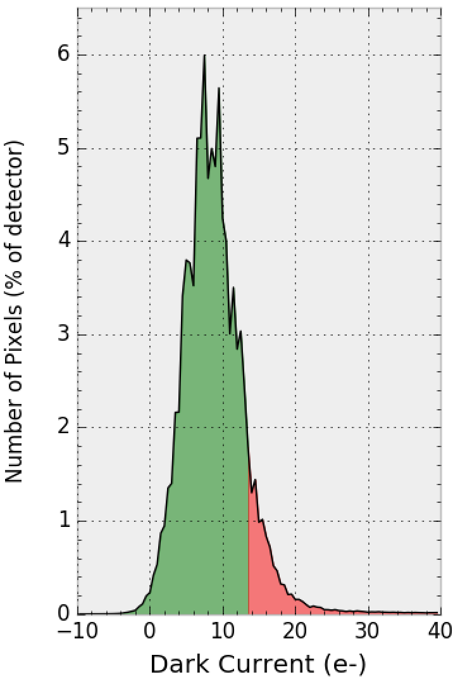
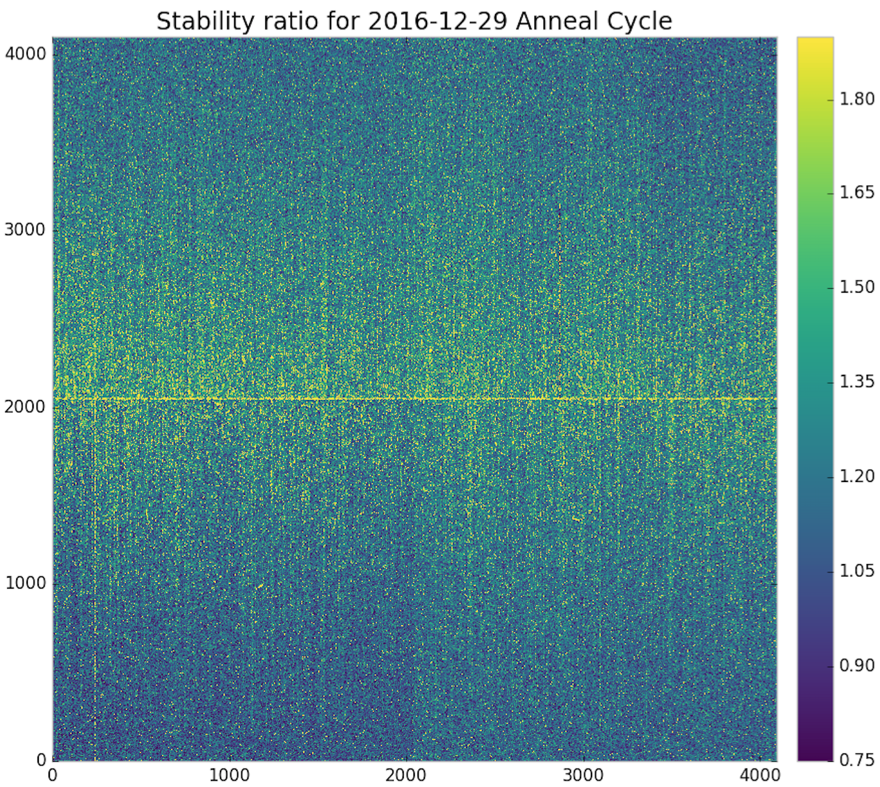
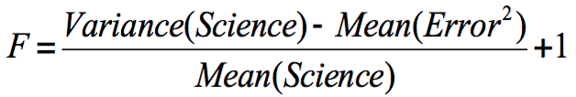
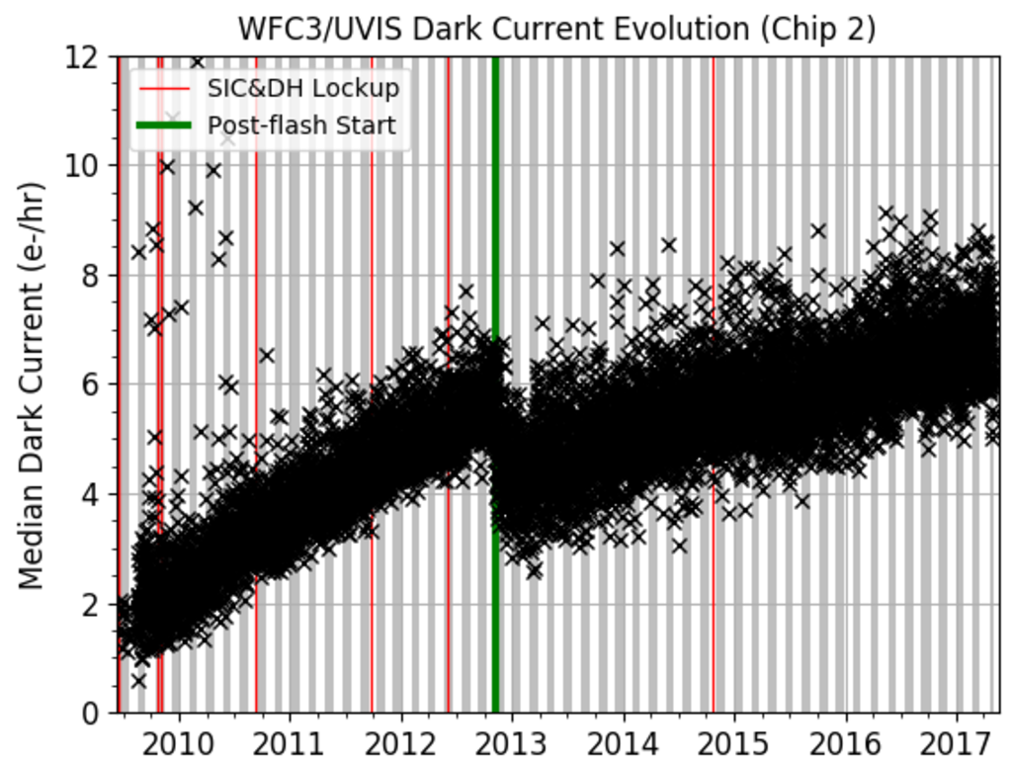
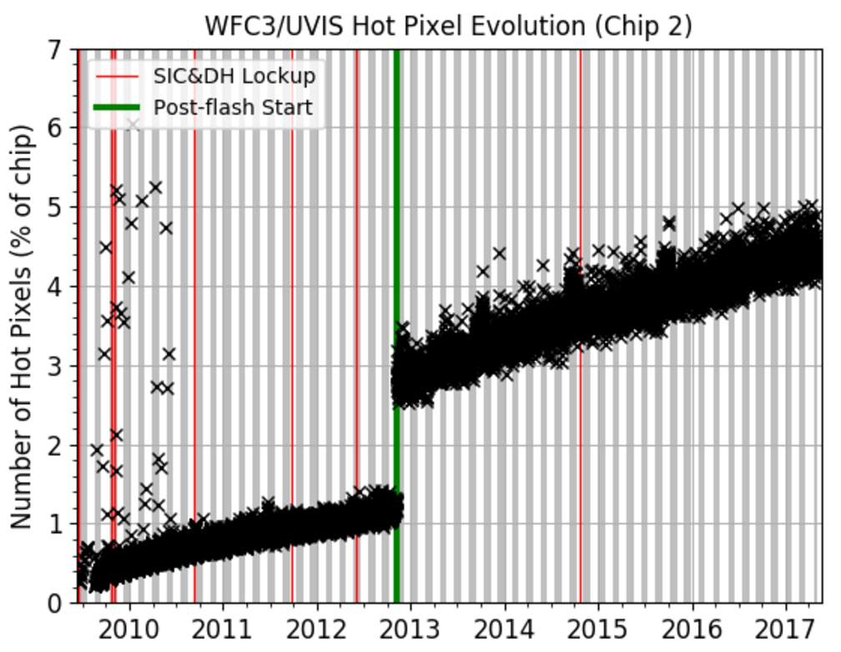
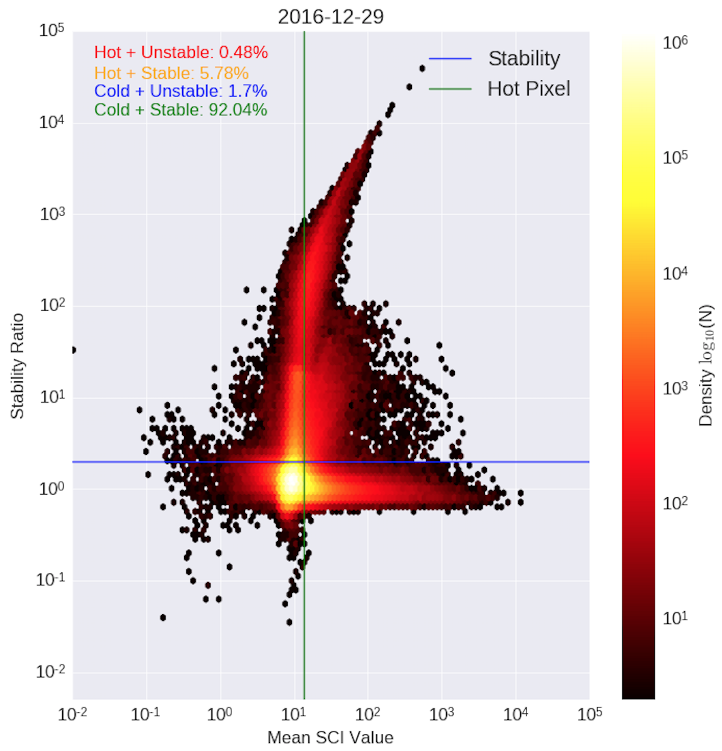
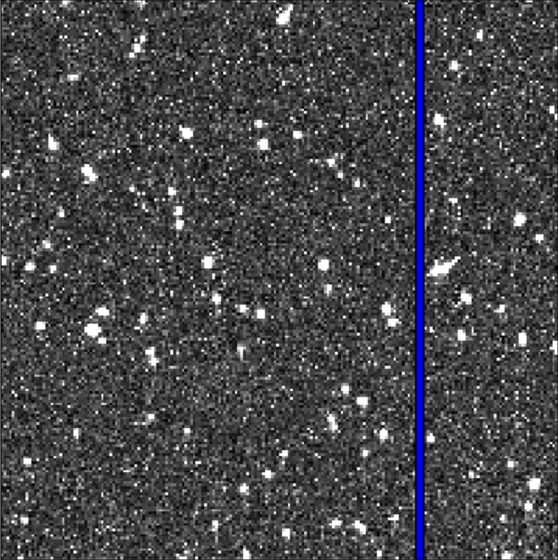
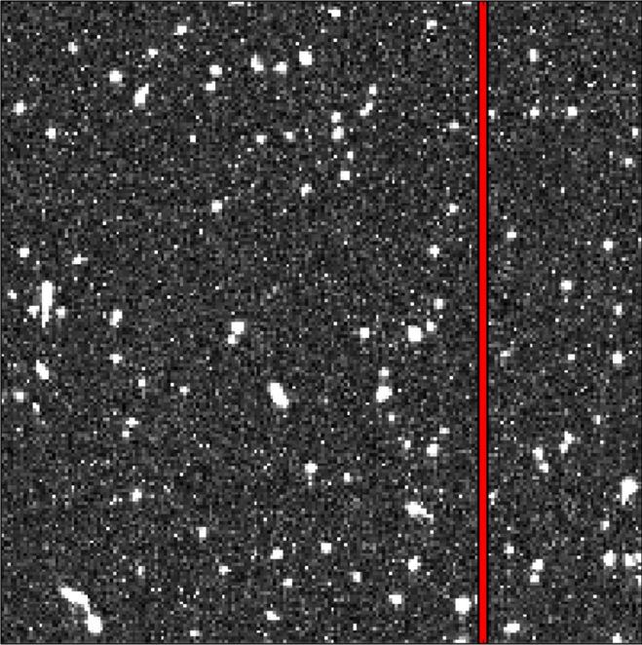
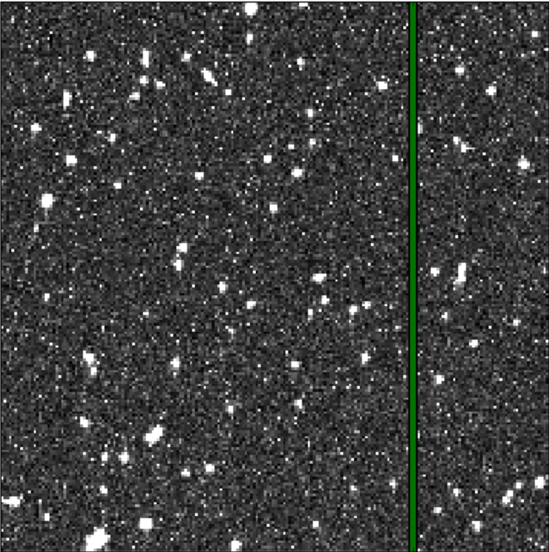
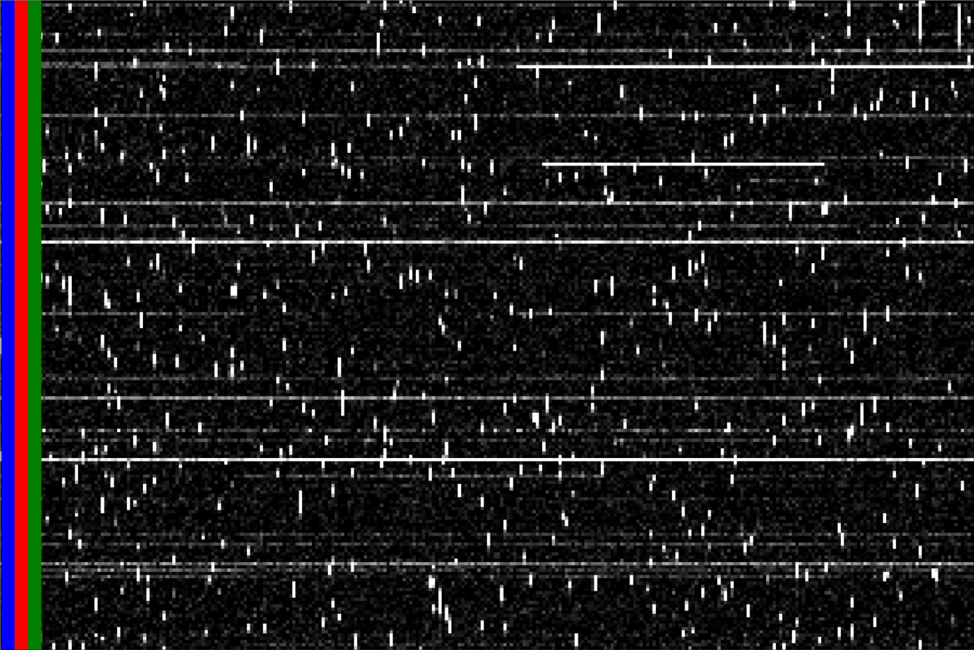
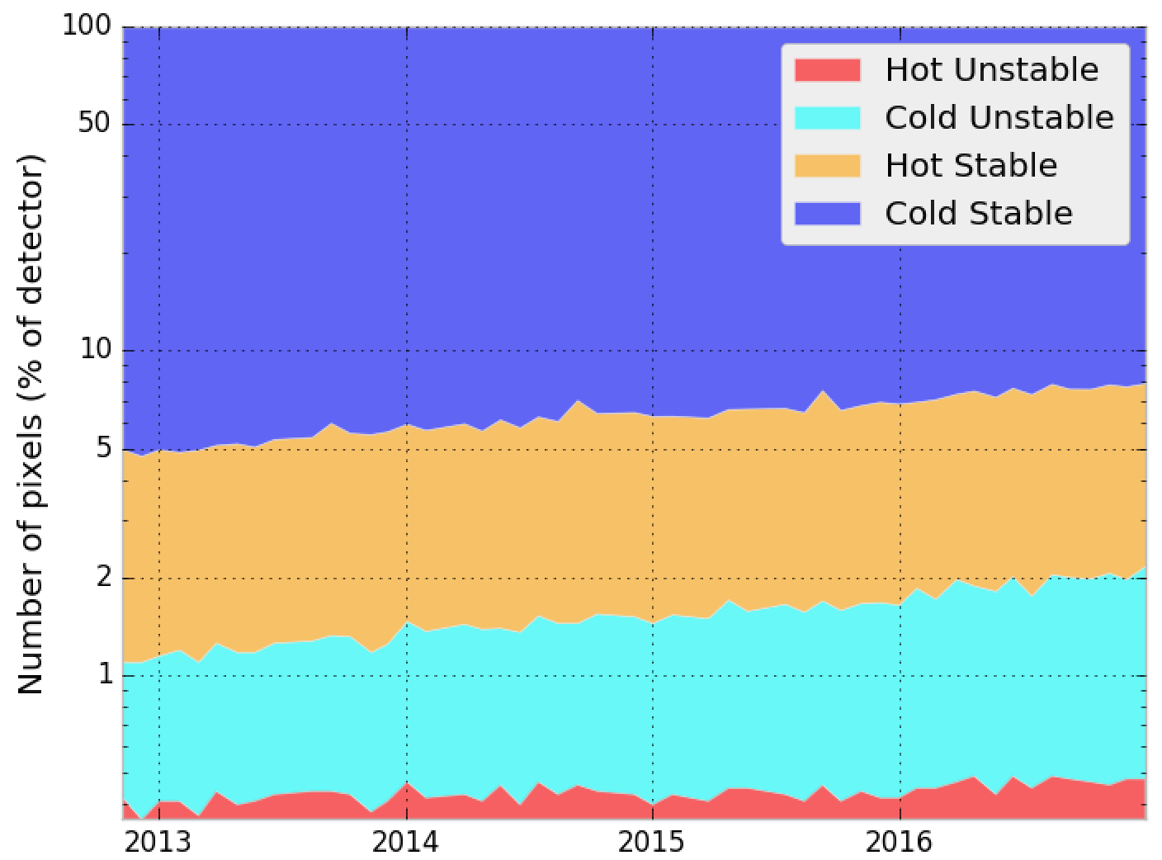
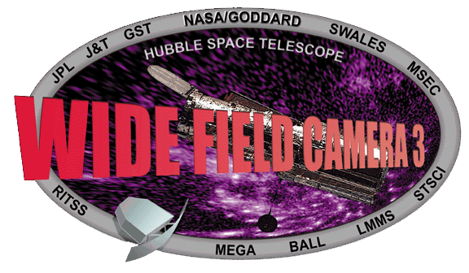


Using Dark Images to Characterize the Stability of Pixels in the WFC3/UVIS Detector
Matthew Bourque, Sylvia Baggett, David Borncamp, Norman Grogin, and the WFC3 Team (STScI)
Abstract
The Ultraviolet-Visible (UVIS) detector on board the Hubble Space Telescope's (HST) Wide Field Camera 3 (WFC3) instrument has been acquiring 'dark' images on a daily basis since its installation in 2009. These dark images are 900 second exposures with the shutter closed as to measure the inherent dark current of the detector. Using these dark exposures, we have constructed ‘pixel history' images in which a specific column of the detector is extracted from each dark and placed into a new time-ordered array. We discuss how the pixel history images are used to characterize the stability of each pixel over time, as well as current trends in the WFC3/UVIS dark current.
UVIS Dark Observations
Pixel Stability
(Left) A 200x200 pixel region taken from a 900-second UVIS dark, showing the nominal features of background dark current, cosmic rays, hot pixels, and CTE trails.
(Right) The distribution of pixel values in a 900-second UVIS dark. The pixels with values exceeding the hot pixel threshold of 54 e-/hr (13.5 e- in 900 sec) are shaded in red. Bin size is 0.5 e-.
For each pixel, we calculate its stability (F) over each anneal cycle using the following equation:
Note that only non-cosmic ray-affected pixels contribute to the stability measurement. The figure on the left shows the stability measurement for each pixel for the Dec 2016 anneal cycle.
F<1: No variance above noise (stable)
F=1: Variance matches noise (stable)
F>1: Some variance above noise (stable)
F>=2: considered “unstable”
Hot Pixels and Dark Current
We aim to classify each pixel into one of four categories:
Cold + Stable: mean(SCI) < 54 e-/hr, F < 2
Cold + Unstable: mean(SCI) < 54 e-/hr, F > 2
Hot + Stable: mean(SCI) > 54 e-/hr, F < 2
Hot + Unstable: mean(SCI) > 54 e-/hr, F > 2
The figure on the right plots the stability of each pixel versus the mean SCI value for the Dec 2016 anneal cycle. Several distinct populations appear:
The median dark current (left) and number of hot pixels (right) over time for Chip 2 (Amps C & D). Dark current increases roughly 0.5 e-/hr/year and is currently ~8 e-/hr. Approximately 1000 new hot pixels above the 54 e-/hr threshold appear every day, currently occupying ~4% of each chip. Each month, the UVIS detector is warmed to +20C (shaded in gray/white regions), erasing 10-20% of the hot pixels.
‘Pixel History’ Images
The number of pixels in each classification for each anneal period since UVIS dark postflashing began in November 2012. Currently, the CALWF3 pipeline flags
t=1
t=2
t=3
with h5py.File(‘pixhist.hdf5’) as f:
data = f[‘{amp}/{col}’].value
t
To efficiently perform pixel stability analyses, we constructed ‘pixel history’ images in which we extracted every column from every on-orbit UVIS dark and placed them into a time-ordered array, yielding a single pixel’s ‘history’ along each row of the pixel history image. Each column’s pixel history image was placed into a Hierarchal Data Format (HDF) dataset using Python’s hdf5 library.
References
ACS ISR: “Pixel History for Advanced Camera for Surveys Wide Field Channel,” Borncamp et al., 2017 (in review)
WFC3 ISR 2016-08: “WFC3/UVIS Dark Calibration: Monitoring Results and Improvements to Dark Reference Files,” Bourque & Baggett, 2016, available at http://www.stsci.edu/hst/wfc3/documents/ISRs/WFC3-2016-08.pdf
This poster and supporting materials available at https://github.com/bourque/AAS-2017-Austin
Poster 117.11

